Slide 1
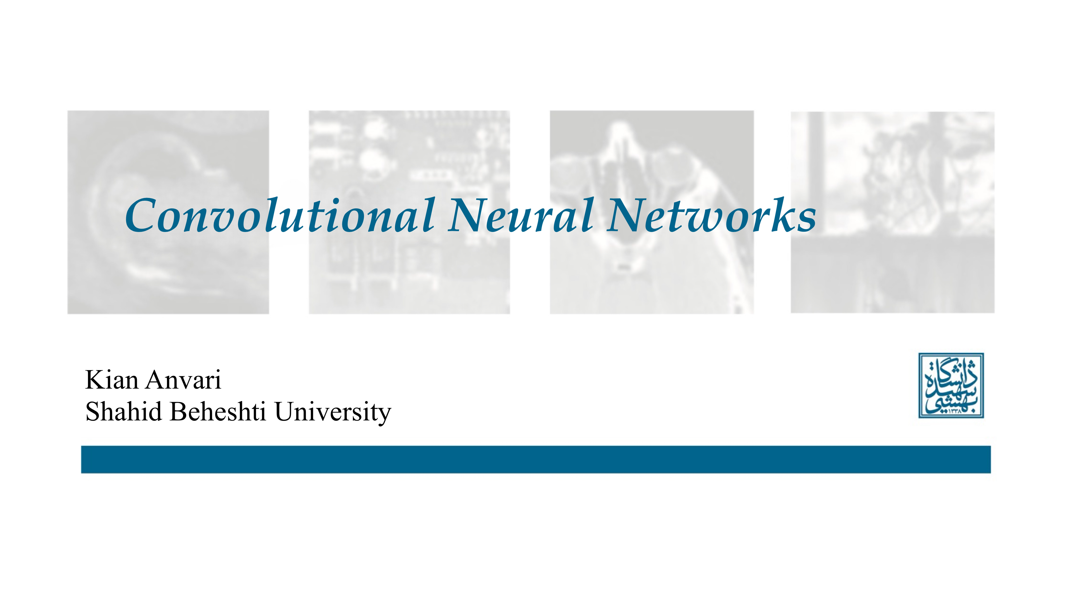

Slide 2
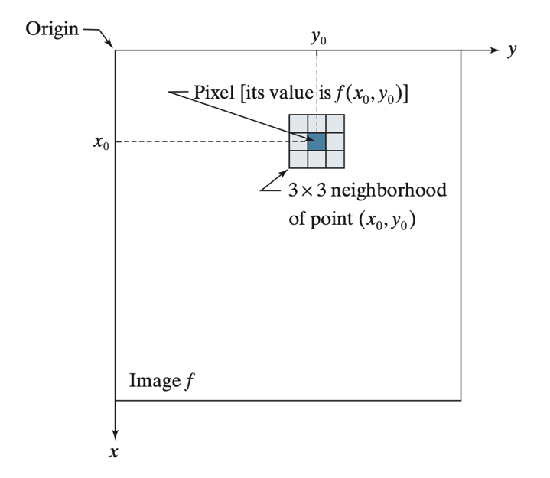
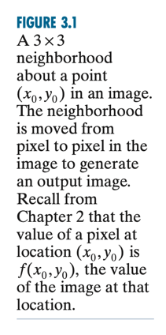
IMAGE FILTERING

Slide 3
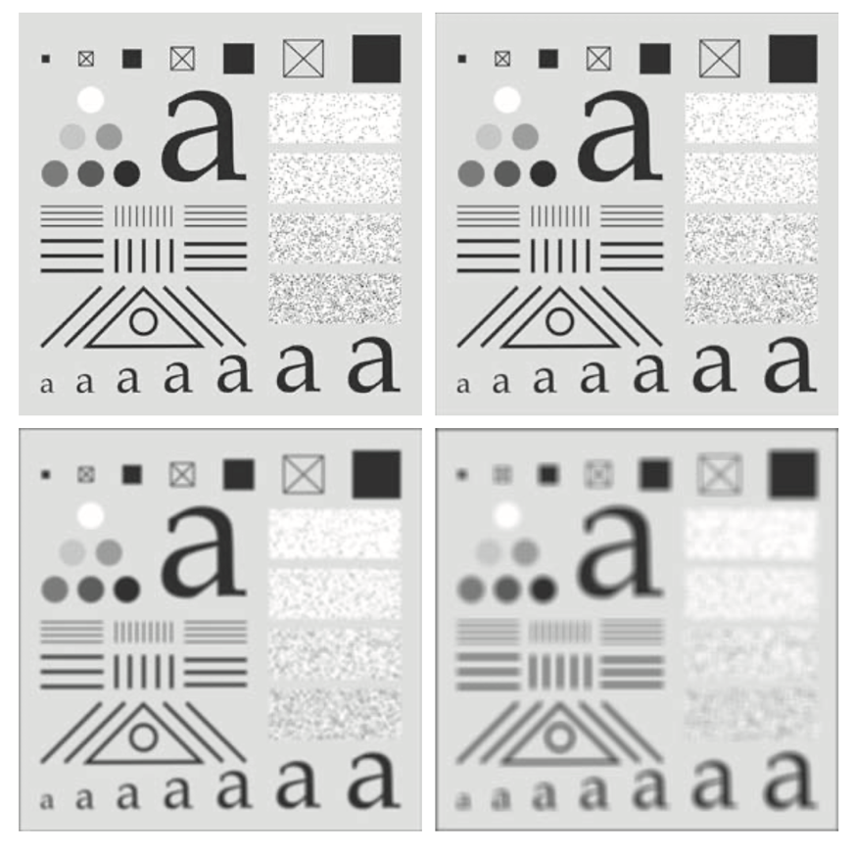
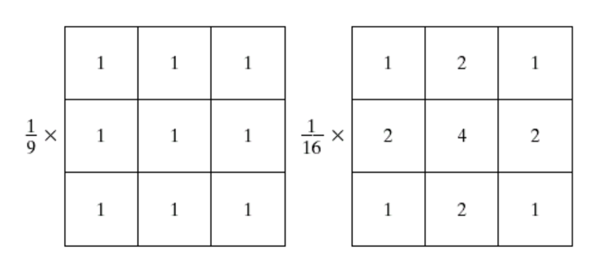
IMAGE FILTERING

Slide 4
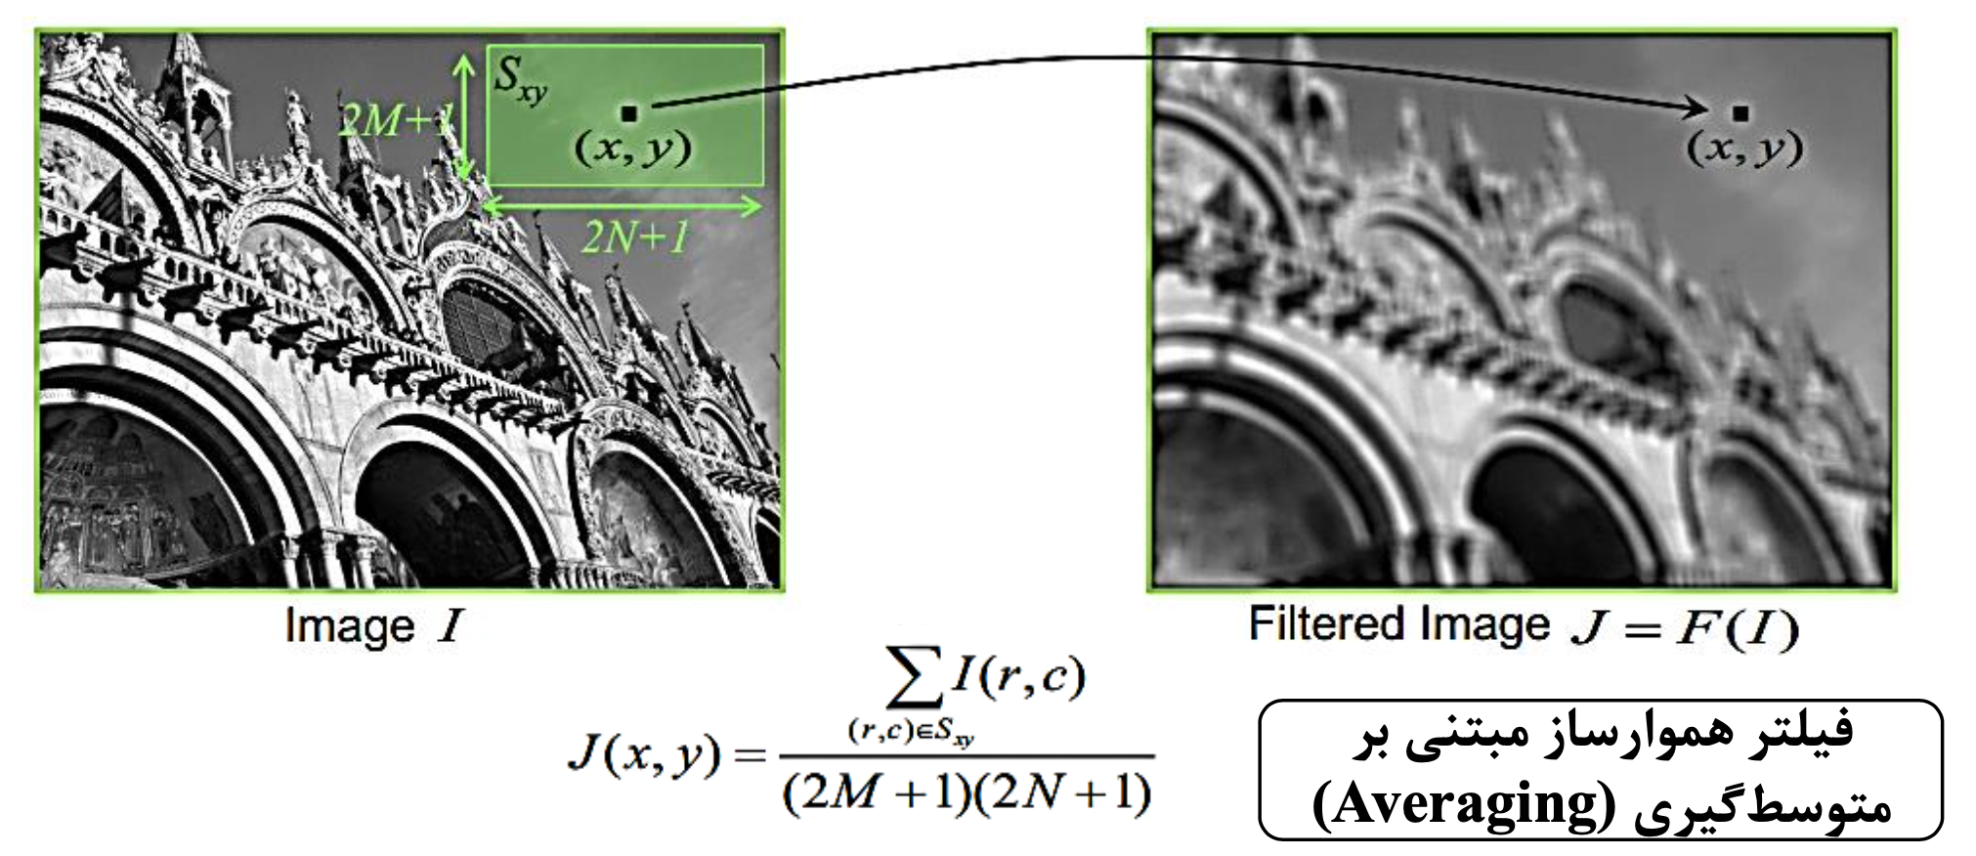
IMAGE FILTERING

Slide 5
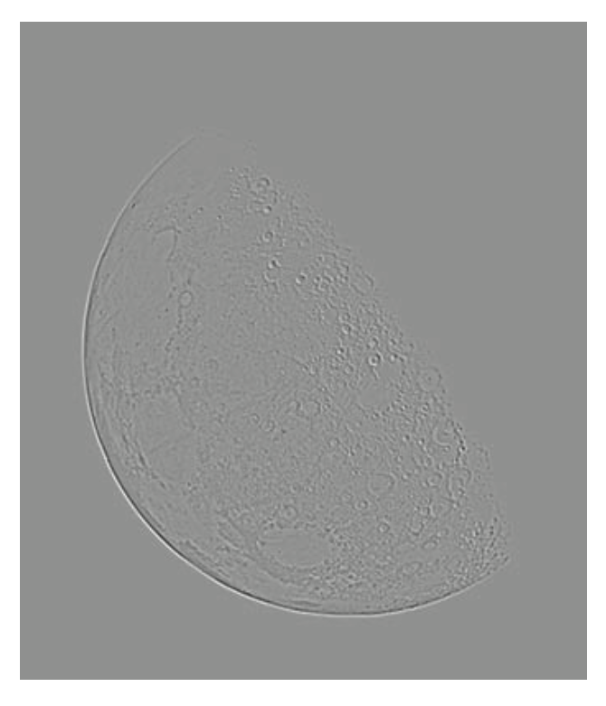
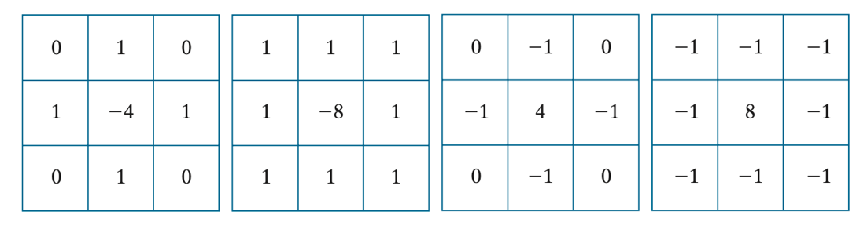
IMAGE FILTERING

Slide 6
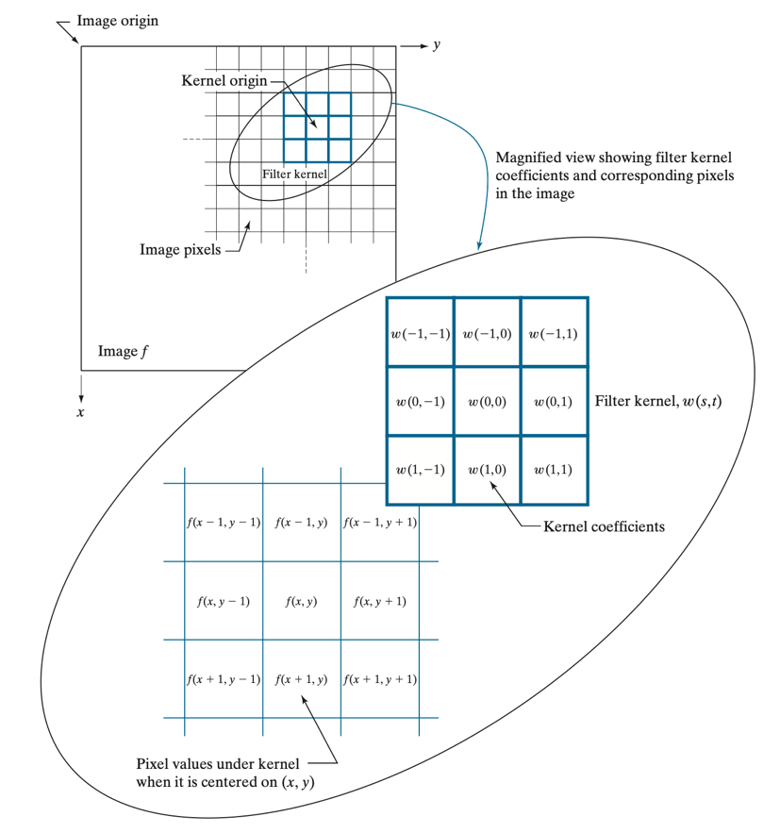
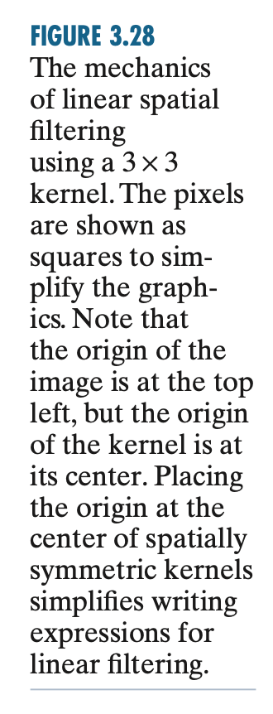
IMAGE FILTERING

Slide 7
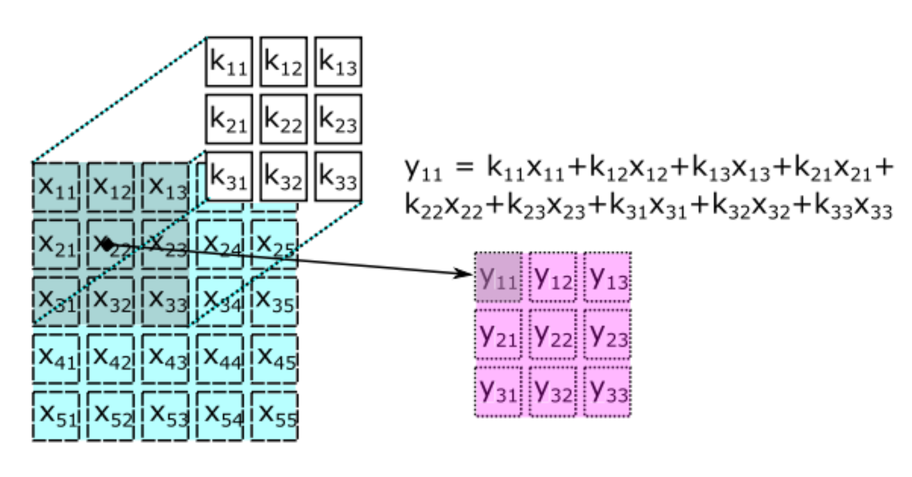
IMAGE FILTERING

Slide 8
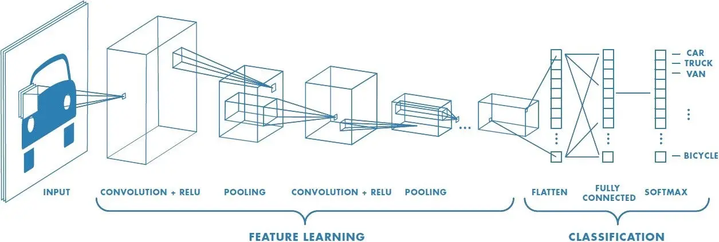
CONVOLUTIONAL NEURAL NETWORKS

Slide 9
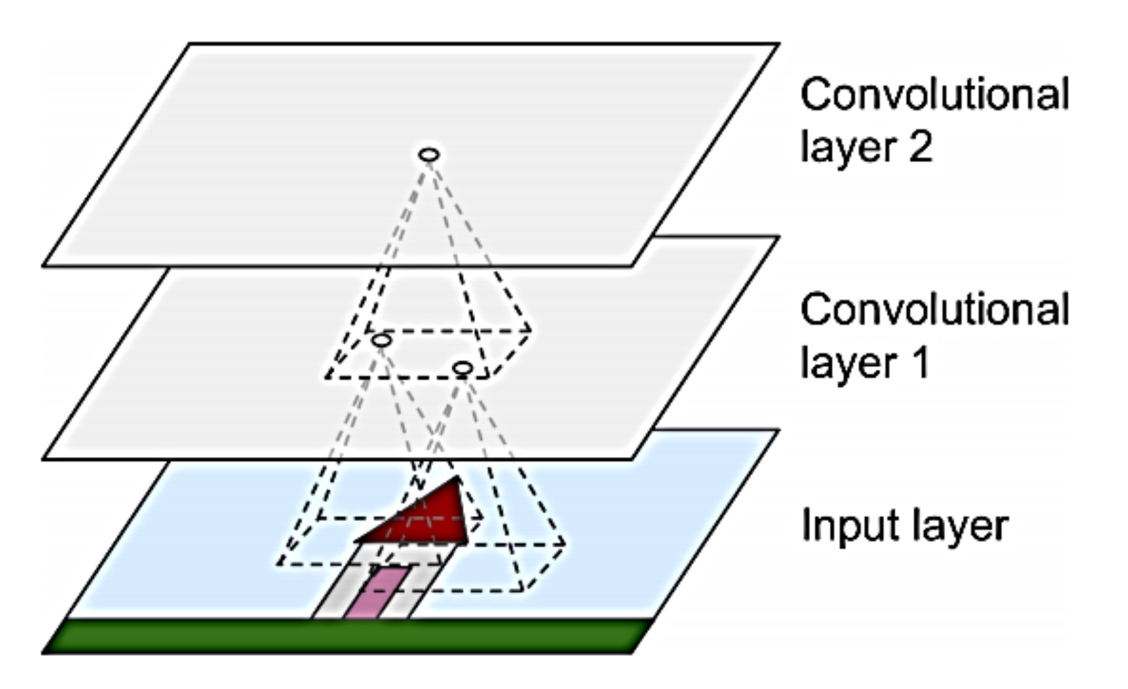
CONVOLUTIONAL LAYERS

Slide 10
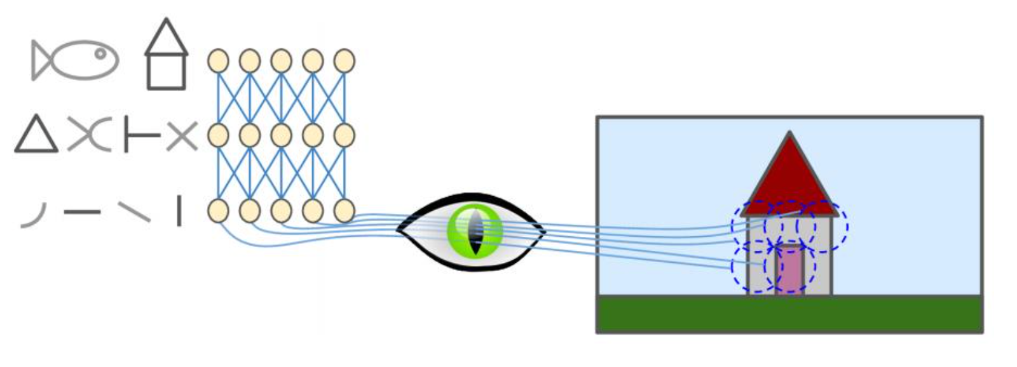
CONVOLUTIONAL LAYERS

Slide 11
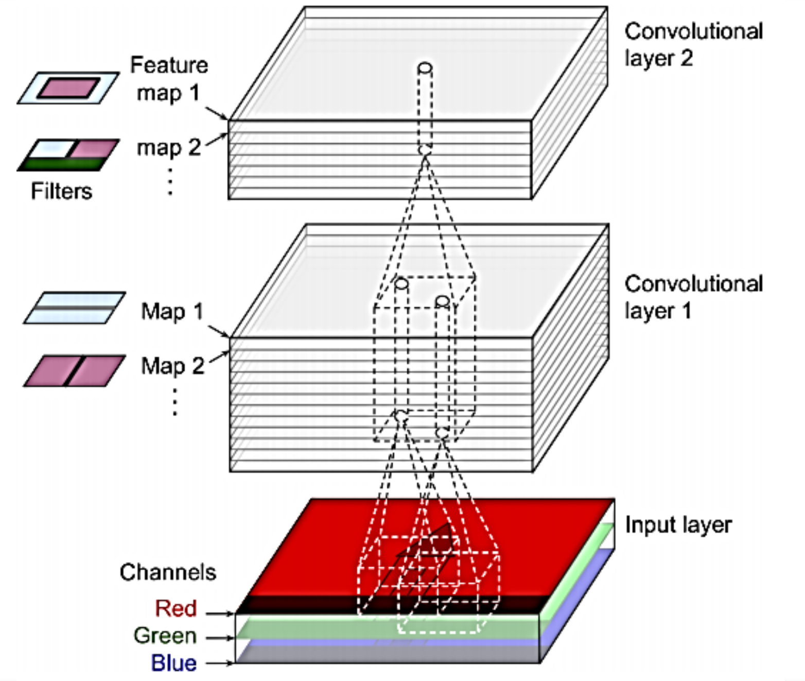
CONVOLUTIONAL LAYERS

Slide 12
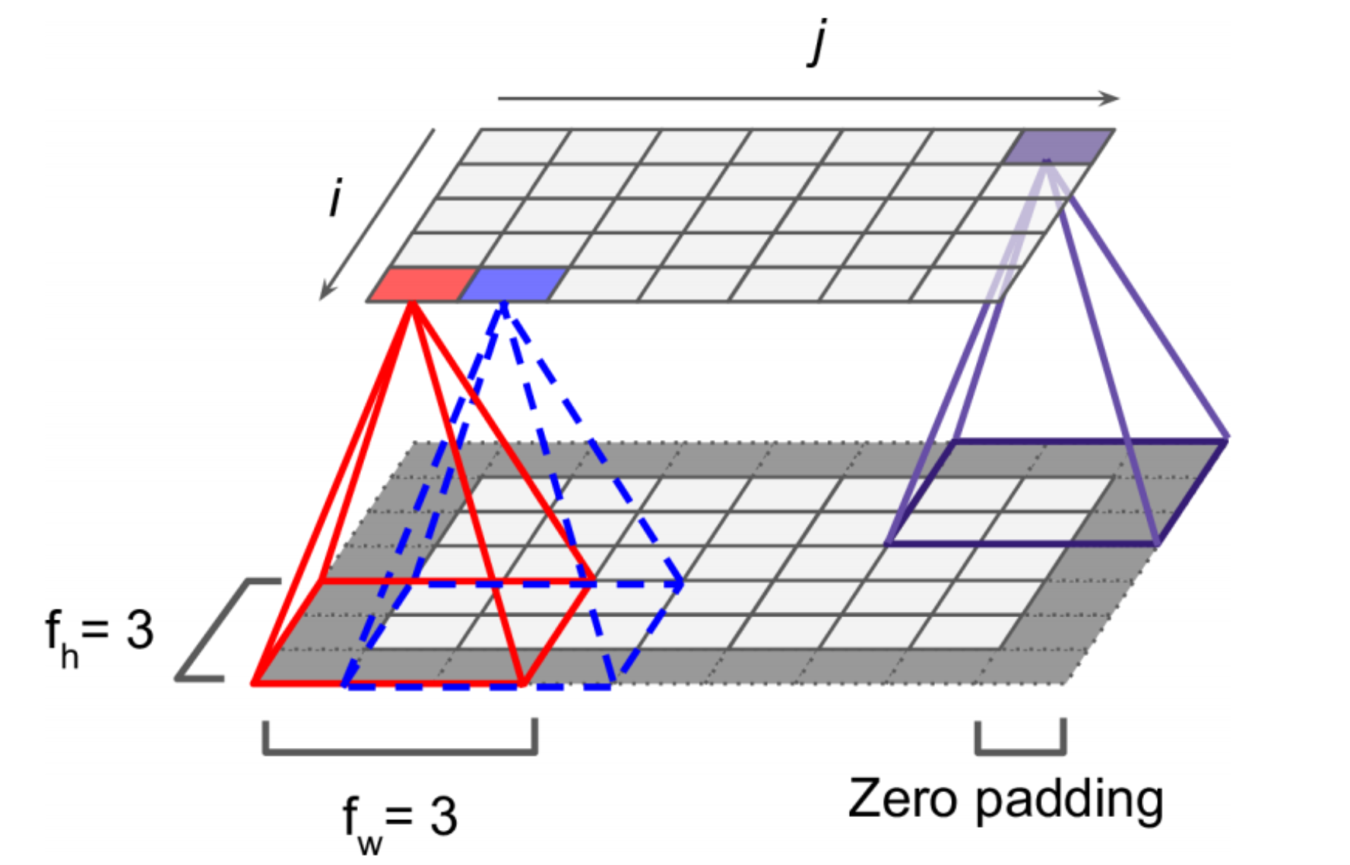
CONVOLUTIONAL LAYERS

Slide 13
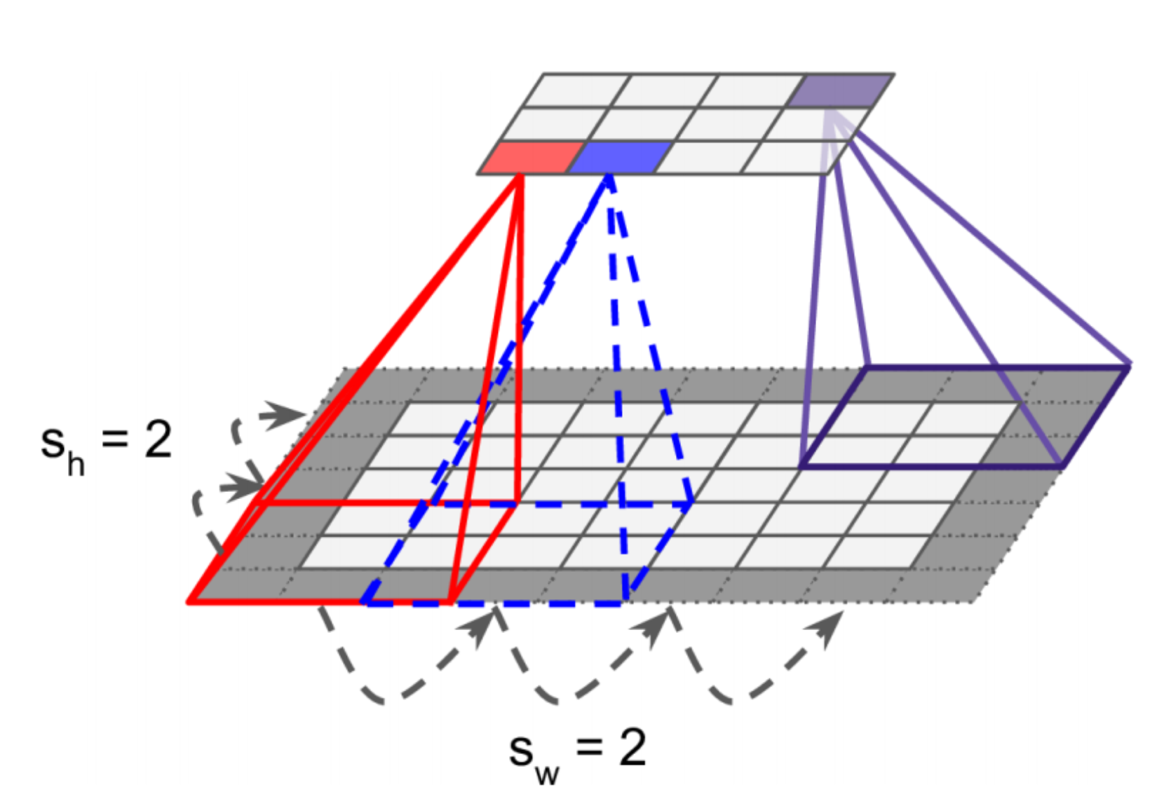
CONVOLUTIONAL LAYERS

Slide 14
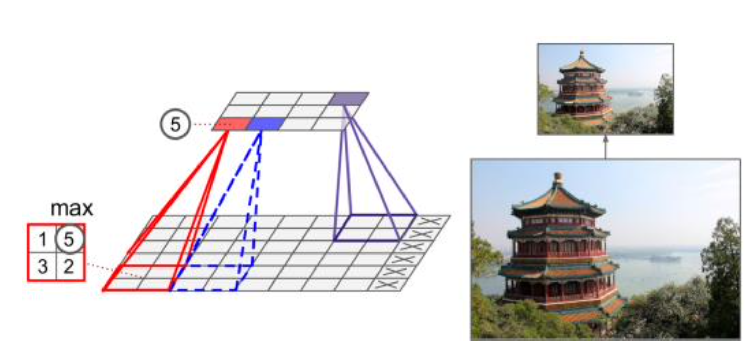
POOLING LAYERS

Slide 15
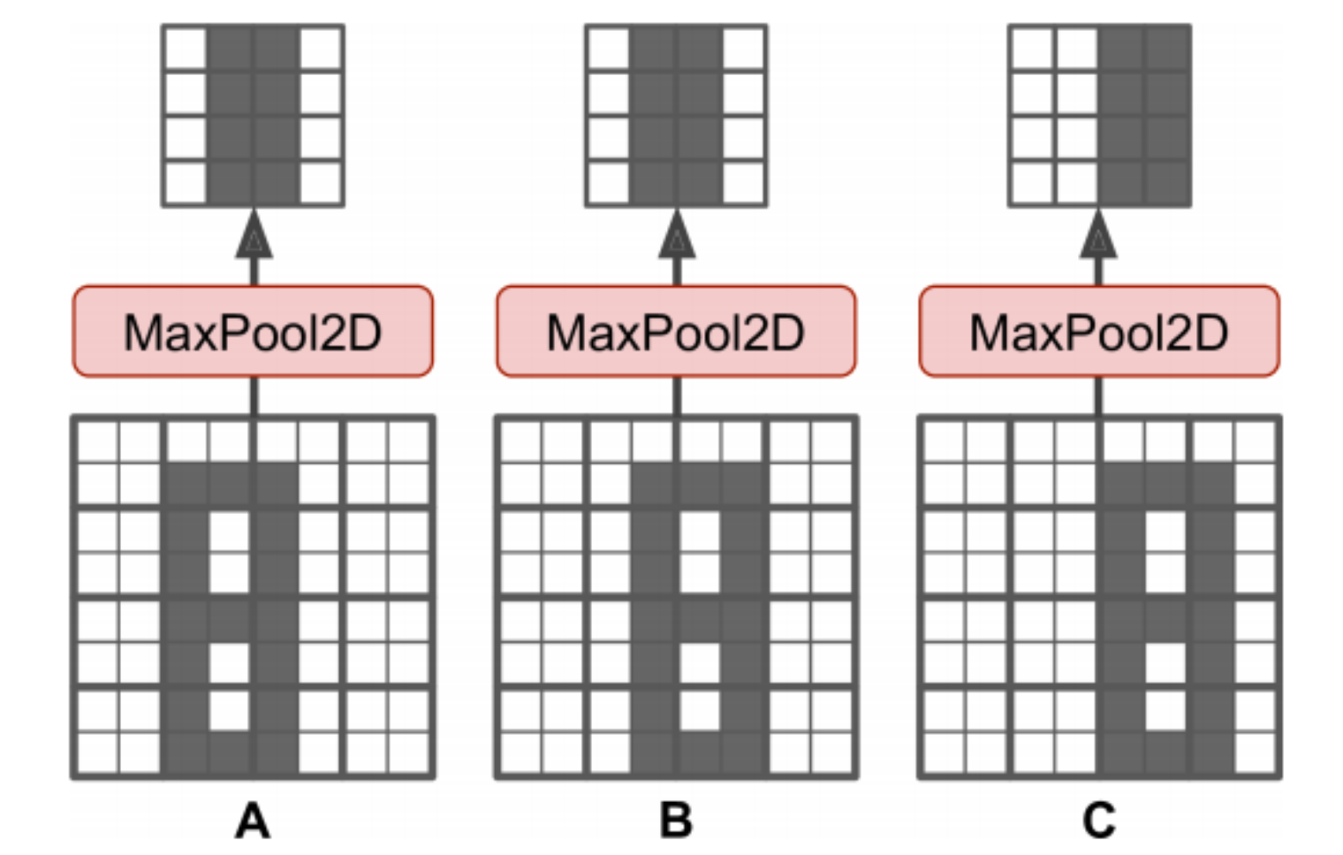
POOLING LAYERS

Slide 16
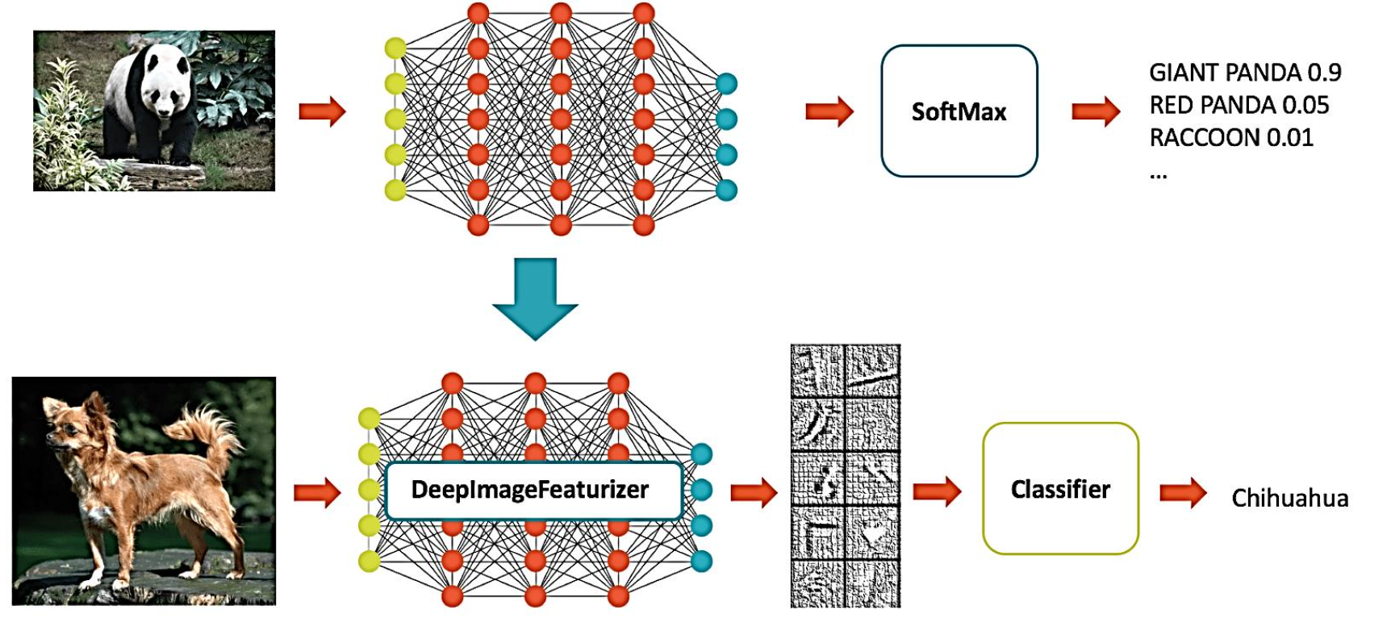
TRANSFER LEARNING

Slide 17
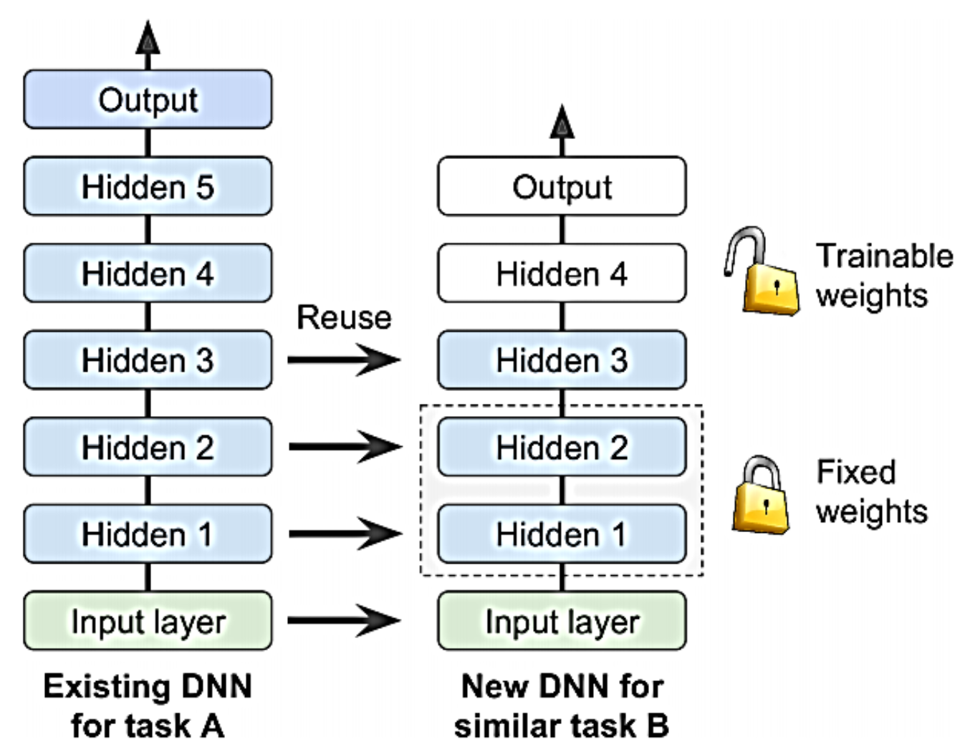
TRANSFER LEARNING
VANISHING GRADIENT

